Slide 1
Exam 2
Matthew Virginia

Slide 2
Models I used
Model | Size
Llama 3.2 | 2gb
TinyLlama | 638mb
Deepseek-r1:7b | 4.7gb

Slide 3
Basic Exploration - Prompts
General QA, What is the capital of Argentina?
Summarization, Summarize the following paragraph: 'Artificial intelligence is a branch of computer science that aims to create machines capable of intelligent behavior. This includes learning, reasoning, problem-solving, and language understanding.'
Code Generation, Write a Python function that checks if a number is prime.
Creative Writing, Write a short story about a robot discovering a forest for the first time.

Slide 4
Basic Exploration - Findings
TinyLlama gave fast replies, but for the summarization prompt it responded in French.
‘L'artificial intelligence (AI) est un domaine de la science du calcul, visant à créer des ordinateurs capables d'agir intelligemment. Ce sont les mêmes méthodes utilisées pour l'intelligence artificielle et les langues universelles pour le raisonnement, le problème-solving, et les compétences de langue profonde.’

Slide 5
Domain Knowledge - Human Resources
"Write a job description for a mid-level software engineer at a startup."
"Create five behavioral interview questions to assess teamwork skills."
"Create a Resume template for a Software Engineer candidate."
"An employee is consistently late and their teammate is frustrated. How should HR handle this?"
"List best practices for promoting diversity in hiring."
"Write constructive feedback for an employee who meets deadlines but struggles with team communication."
"Draft a welcome email for a new hire joining the marketing department, including their first-day schedule."
"Write a professional and empathetic message to notify an employee of a layoff due to organizational restructuring."
"Create a remote work policy that outlines expectations, communication guidelines, and eligibility criteria."
"Explain how to conduct a salary benchmarking analysis for a new role in the tech industry."

Slide 6
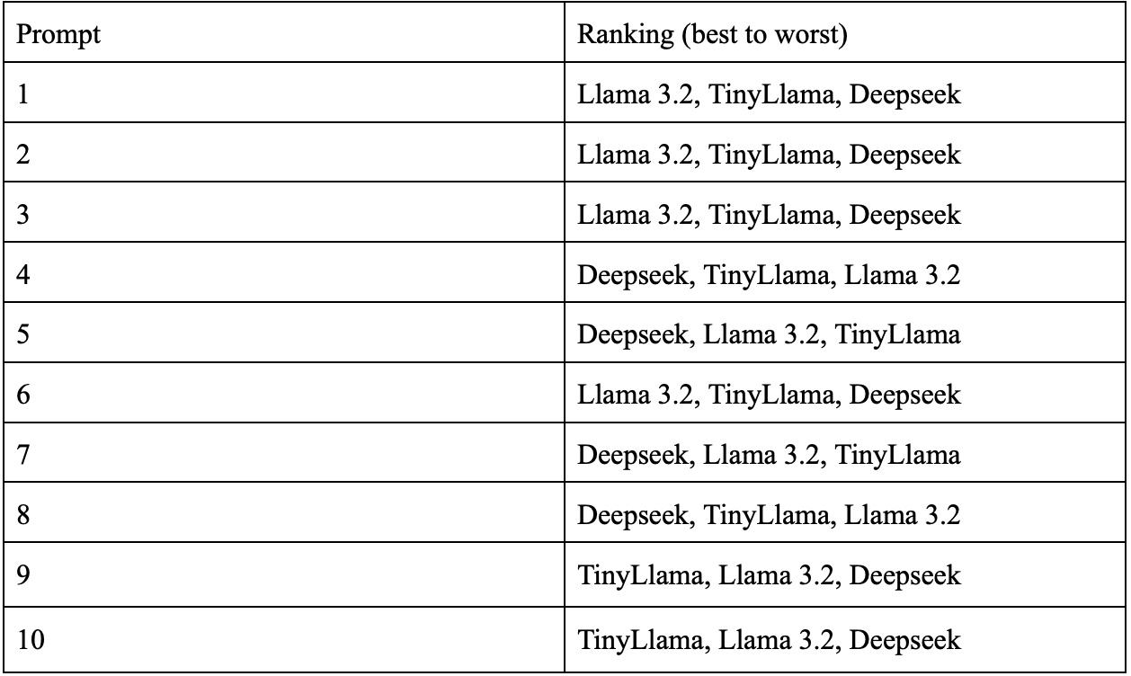
Domain Knowledge - Human Resources

Slide 7
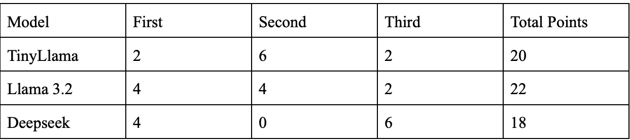
Domain Knowledge - Human Resources

Slide 8
Statistics
DeepSeek: longest response time 46.07 seconds, the most CPU usage (34.80%), as well as most RAM usage 14,701 MB
TinyLlama: quickest response speed 3.69 seconds, CPU usage 18.3%, as well as RAM usage 12,612 MB
Llama 3.2: response time 11.33 seconds, CPU usage 33.3%, and RAM usage of 14,221 MB

Slide 9
Summary

